Slide 1

Pairwise Testing
Testing Independent Options
Software Quality Assurance
Telerik Software Academy
http://academy.telerik.com

Slide 2


The Lectors
Nikolay Nedyalkov
QA Architect
XAML Division
email: nikolay.nedyalkov@telerik.com
Petar Horozov
Senior QA Engineer
XAML Team2
email: petar.horozov@telerik.com

Slide 3

Table of Contents
What Is Pairwise Testing
Fault Modes
Models of Pairwise Testing
All-pairs Tables
Orthogonal Arrays
Orthogonal Arrays vs. All-pairs Tables
Generation of Pairwise Test Tables

Slide 4
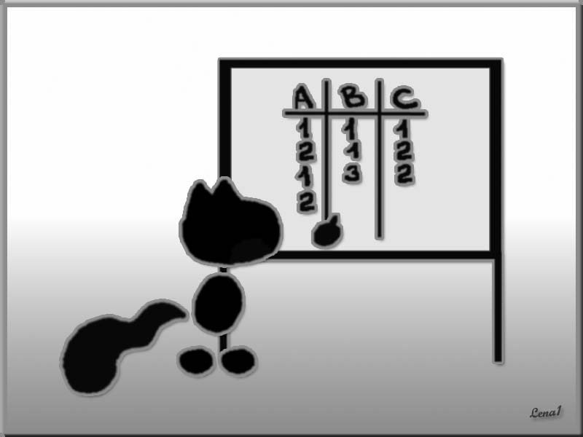
What Is Pairwise Testing
Main Concepts

Slide 5

Testing Non-interactional Factors
In some cases the interaction between separate factors in a system cannot be easily determined, or even there is supposed to be no interaction
E.g. a browser based application should run properly regardless of the configuration of the environment
For such cases we can use pairwise testing

Slide 6

What is Pairwise Testing?
What is pairwise testing?
A black-box test design technique
Test cases are designed to execute all possible discrete combinations of each pair of input parameters
Used for testing unconstrained options

Slide 7
Unconstrained Options
Unconstrained options are those that are independent of each other
Any options for any factor can coexist with any other option for any other factor
Configuration testing is a classic example of that
Pairwise testing is used to control "combinatorial explosions" related to testing unconstrained options

Slide 8

The Coverage Criterion
Pairwise testing follows a simple coverage criterion:
We make sure that each option is represented in at least one test configuration
Each possible pair of options is represented in at least one test configuration
Each option and pair of options is represented about equally as a percentage of the total configurations

Slide 9

Fault Modes
How Many Factors Are Needed for a Bug?

Slide 10

Single-mode Bugs
The simplest bugs are single-mode faults
Occur when one option causes a problem regardless of the other settings
E.g., a printout is always smeared when you choose the duplex option in the print dialog box
Regardless of the printer or the other selected options

Slide 11

Double-mode Faults
Double-mode faults
Another type of bug is one that occurs when two options are combined
E.g., the printout is only smeared when duplex is selected and the printer is a model 394

Slide 12

Multi-mode Faults
Multi-mode faults
Occur when three or more settings produce the bug
This is the type of problems that make complete coverage seem necessary

Slide 13

Is It Worth It?
Suppose the printer error only occurs when
The operating system is Windows
The print option is set to duplex
The print quality is draft
The Collate option is not selected
Is it worth your time to find that bug?
Does the bug present a big enough risk to the user or application that it will even require a software fix?
Notes:
RTB on Mac in Chinese

Slide 14

So, What Do We Do?
The pairwise testing covers only combinations of two options
The basic bug hypothesis is that this level of coverage is sufficient
Most problems are considered to arise either from a single instance of an option or from a given pair of options

Slide 15
What About Combinations of More Options?
Complete coverage is usually not necessary
Most field faults were caused by either incorrect single values or by an interaction of pairs of values
Higher-order combinations are usually not tested
E.g., triples, quadruples, quintuples, etc.
Such higher-order combinational problems are considered to be less likely

Slide 16

Finding 90% of flaws is pretty good, right?
Less than 100% is a statistically acceptable level of quality
Except for critical applications where life and death are at stake
“Relax, our engineers found 90 % of the flaws.”

Slide 17
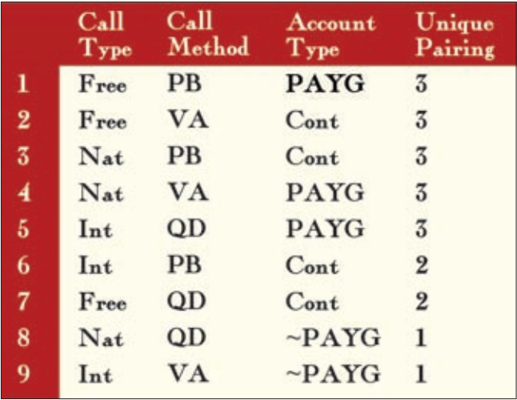
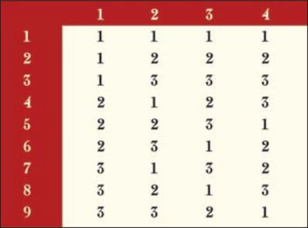
Models of Pairwise Testing

Slide 18

Models of Pairwise Testing
There are two basic models for pairwise testing:
Orthogonal arrays
All-pairs tables
Both of these models are represented as tables
Tables, read row-wise specify which particular options to be included in a given test configuration
Notes:
Фактор – Колона
Case - Row

Slide 19

Pairwise Testing Tables
Creating tables depends on the basic model chosen:
All-pairs tables - tables are created directly
Orthogonal arrays - by mapping the test problem to be solved onto an existing table

Slide 20

Pairwise Testing Tables
Tables are guaranteed to contain:
All existing options for every factor at least once
Every pair of options across all pairs of factors

Slide 21
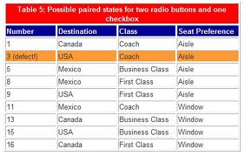
All-pairs Tables

Slide 22

All-pairs Tables
All-pairs Tables
A way for generating pairwise tests
Pairs are generated directly using an algorithm
Without resorting to an "external" device like an orthogonal array

Slide 23

Utilities for All-pairs Tables Generation
Free utilities are available for automatic generation of all-pairs tables:
“Allpairs” by James Bach
Available at http://www.satisfice.com
"AETG" from Telcordia
Available at http://aetgweb.argreenhouse.com/
“pict” by Jacek Czerwoner at Microsoft
“Classification Tree Editor CTE”

Slide 24
Handling Constraints
In some cases constraints actually exist
Between certain choices of some of the variables
E.g., Microsoft's IIS and Apple's MacOS are not compatible
Tools like rdExpert and AETG have the ability to define and follow such requirements
Doing this by hand can be difficult

Slide 25
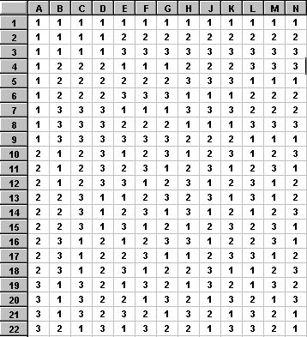
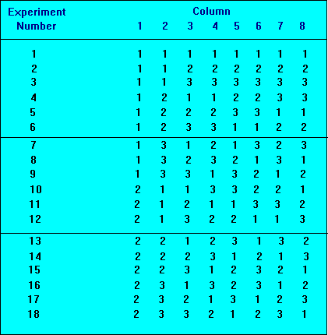
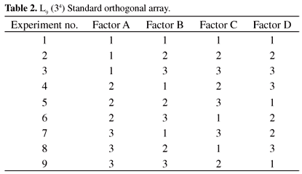
Orthogonal Arrays

Slide 26
Orthogonal Arrays
Orthogonal Array
A two-dimensional array constructed with special mathematical properties
Choosing any two columns in the array provides every pair combination of each number in the array

Slide 27
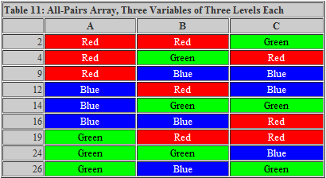
Orthogonal Array Testing
Orthogonal Array Testing
Significantly reduces the number of all combinations of variables to test all pair combinations

Slide 28

Resources on Orthogonal Arrays
There are plenty of orthogonal arrays available on the Internet and in various textbooks
http://neilsloane.com/oadir/
http://www.freequality.org/documents/tools/Tagarray_files/tamatrix.htm
Tools can also be used for building all pairs tables
http://blogs.msdn.com/b/nagasatish/archive/2006/11/30/pairwise-testing-pict-tool.aspx

Slide 29
Orthogonal Arrays Example
This is the simplest possible orthogonal array:
 | Factors
Tests | 1 | 2
1 | 0 | 0
2 | 0 | 1
3 | 1 | 0
4 | 1 | 1

Slide 30
Orthogonal Arrays Example (2)
This is a larger orthogonal array example:
 | Factors
Tests | 1 | 2 | 3
1 | 0 | 0 | 0
2 | 0 | 1 | 1
3 | 1 | 0 | 1
4 | 1 | 1 | 0
Why there are more factors, but still only four rows (tests)

Slide 31

Selecting an Orthogonal Array
Setting the Appropriate Parameters

Slide 32

Rules for Selecting Orthogonal Arrays
There are three rules for selecting an orthogonal array:
There must be at least as many columns as factors
If there are too many columns, the extra columns can be dropped

Slide 33
Rules for Selecting Orthogonal Arrays (2)
There are three rules for selecting an orthogonal array:
There must be at least enough numbers in the columns to hold the options for each factor
Spare numbers that don't map to any option can be replaced by any valid option for that factor
This is referred to as "tester's choice" and usually shown with a tilde (~)

Slide 34
Rules for Selecting Orthogonal Arrays (3)
There are three rules for selecting an orthogonal array:
There must be at least as many rows as the product of the two largest numbers of options
E.g., if the factors with most options have 4 and 3 options then we need at least 4 * 3 = 12 rows
If there are too many rows, combining them is possible, but must be done carefully

Slide 35


Filling an Orthogonal Array
Mapping a Testing Problem into an Orthogonal Array

Slide 36

Filling an Orthogonal Array
After selecting an orthogonal array the testing problem have to be mapped into it following a six-step process
This process is entirely mechanical and very easy to do in Excel or Word

Slide 37

The 6-step Process
Download a template according to your selection (usually a text file) and import it into Excel or Word
Drop any extra columns that you might have
Map factors to the columns by adding column headings

Slide 38
The 6-step Process (2)
Select one column at a time and map the options for that factor onto the numbers
Replace the numbers (0, 1, etc.) with the respective option for that factor
Using Word's or Excel's search and replace options makes this easy
If you finish this process and there are still numbers in the column, replace those numbers with tildes to indicate "tester's choice"

Slide 39

The 6-step Process (3)
Drop any extra rows with no interesting single options or pairs of options
I.e. any row that consists of all tildes can be deleted
Merging pairs of rows:
Where one row has tildes and another row has options and vice versa
Where any option specified in each row is the same

Slide 40

The 6-step Process (4)
For any spare cells (still having tildes) you can specify arbitrary options
Options that will make for tests easier
Options that cover popular configurations
Any options you like
This step can be performed during test execution

Slide 41
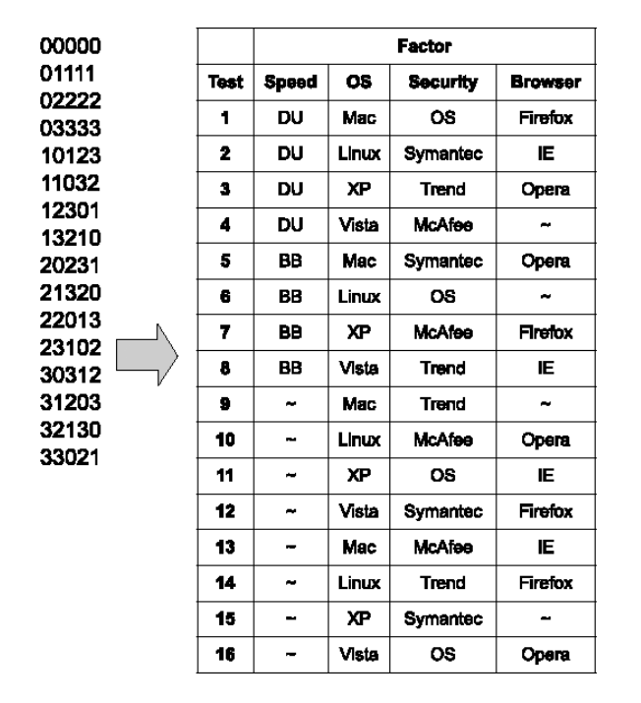
Filling an Orthogonal Array
Demo
Notes:
GridView Selection example

Slide 42

Generation of Pairwise Test Tables

Slide 43
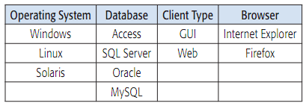
Identifying Variables
Before implementing all-pairs testing, we need to identify the variables
E.g., a sign-on component of a sales application might have the following variables:
An exhaustive testing would have 48 combinations (3 x 4 x 2 x 2)

Slide 44
Creating the First Pair of Values
After identifying the variables, a spreadsheet can be used to combine the values from a pair of variables
Variables should be arranged by the number of values they contain from greatest to least
3
4
2
2

Slide 45
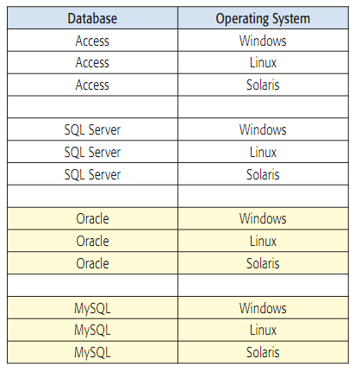
Creating the First Pair of Values (2)
Match each value of the first factor with each value of the second one
Skip a row to improve readability

Slide 46
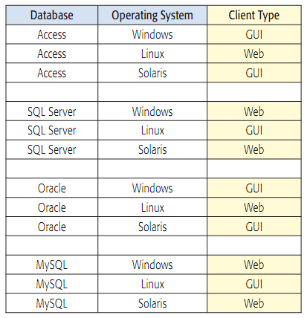
Adding a Third Value
Add a third variable
Start by entering the values in order in a third column, repeating as necessary

Slide 47
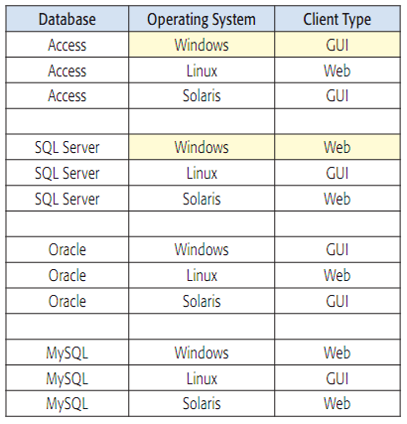
Adding a Third Value (2)
Compare the combinations
Make sure you have all the possible pairs for the second and third variables

Slide 48
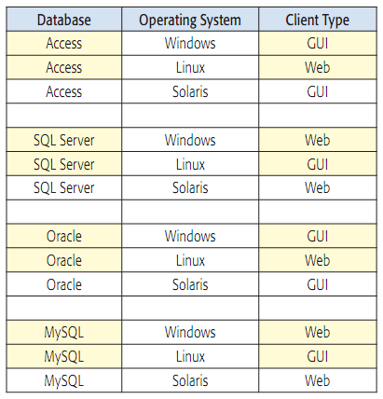
Adding a Third Value (3)
Compare the combinations between the first and third variables
If a pair is missing, rearrange the values to create the necessary combinations

Slide 49
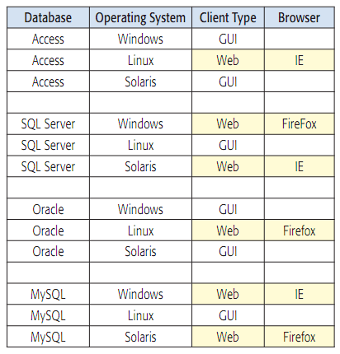
Adding More Variables
If there are more variables, continue the same procedure of creating pairs with them

Slide 50
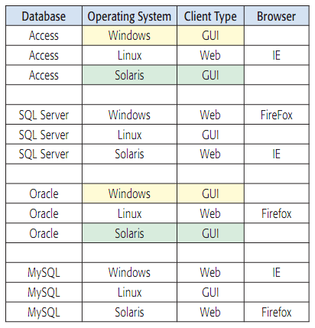
Check Again
Check for missing or duplicate pairs
There are no FireFox / Access and IE / Oracle pairs
Windows / GUI and Solaris / GUI pairs are duplicated

Slide 51
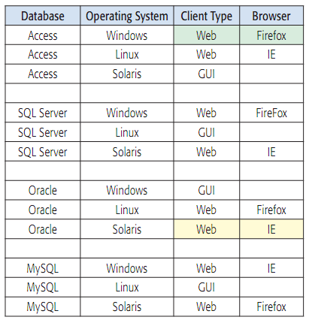
Rearrange and Optimize
Duplicated pairs can be used to correct missing ones
Affecting other rows is sometimes not needed

Slide 52
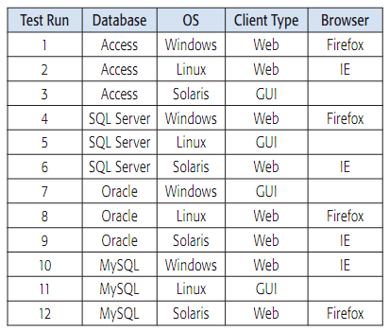
Finalizing the Procedure
Add a column and number the test runs for easy reference
12 tests is better than 48!

Slide 53
Pairwise Testing
?
?
?
?
?
Questions?
?
?
?
?
?
?

Slide 54
Exercises
Determine the set of pairwise test cases for the examples, presented on the next slides. Do it once by using an orthogonal array and once again – using an all-pairs algorithm.

Slide 55
Exercises (2)
A bank has created a new data processing system that is ready for testing. Consider the following factors:
Types of customers: consumers, very important consumers, businesses
Types of accounts: checking, savings, mortgages, loans
Accounts are operated in different states, each with different regulations: California, Nevada, Utah, Idaho, Arizona

Slide 56
Exercises (3)
Suppose you need to test compatibility of various kiosk configurations based on three major factors, each set to one of the options shown:
Operating System: Windows XP or Linux
Browser: Internet Explorer (Windows only), Netscape, or Opera
Connection: DSL, dial-up, or cable

Slide 57
Exercises (4)
Suppose you need to test a web site and the combinations of software it should operate with, considering the following factors:
Browser - Internet Explorer, Netscape, Mozilla, and Opera
Plug-in - None, RealPlayer, and MediaPlayer
Client operating system - Windows 95, 98, ME, NT, 2000, and XP
Server - IIS, Apache, and WebLogic
Server operating system - Windows NT, 2000, and Linux

Slide 58
Exercises (5)
Consider a system for constructing e-commerce sites that must support various client and server configurations. Suppose you have the following seven factors with the options shown (real names of the options are replaced with letters for simplicity):
Browser (A, B, C)
Host OS (A, B, C)
Speed (A, B, C)
Web server (A, B, C)
Application server (A, B, C, D, E)
Database server (A, B, C, D, E)
Server OS (A, B, C, D)

Slide 59




Free Trainings @ Telerik Academy
C# Programming @ Telerik Academy
csharpfundamentals.telerik.com
Telerik Software Academy
academy.telerik.com
Telerik Academy @ Facebook
facebook.com/TelerikAcademy
Telerik Software Academy Forums
forums.academy.telerik.com

